Slide 1

HSBC Escrow / Trust Solution Analysis
Mar 2021

Slide 2
Account Type – Pro/Con Analysis
Trust Account – HSBC own, not require investor to open AC with HSBC
Escrow Account -Not require Investor Confirmation for every Debit
Escrow Account – Require Investor Confirmation for every Debit
HSBC Risk management and Compliance Approval
User Experience / Client Onboard / System Integration / Ongoing Operation

Slide 3
Investor relationship with HSBC
Institutional Investor Background | Escrow Account Opening KYC/AML /Document process
Existing HSBC SG Customer | Simple
Existing HSBC Other Country’s Customer | Medium
Non-HSBC Customer | Complex
Notes: To quickly start the sandbox express testing, recommend to find intuitional investors who have already opened A/C with HSBC SG.

Slide 4
Trust Account vs. Escrow Account
 | Escrow Account | Trust Account
定义 | An escrow account is a third party account where funds are kept before they are transferred to the ultimate party. It provides security against scams and frauds especially with high asset value and dispute-prone sectors like Real Estate. Escrow-based payments have been around for years and are not new. However, they have mostly been restricted to large transactions, like mergers and acquisitions, cross-border deals, etc. Industry experts say, with new technology and the rise of the internet-based economy, this instrument is used by stakeholders from several sectors to have safe and secure transactions. Escrow accounts are a financial instrument in which an asset or escrow money is held by a third party on behalf of 2 other parties that are in the process of completing a transaction. Escrow accounts can hold money, securities, funds, and other assets. 监管账户对于所有资金和资产的交割存在时间差的交易，都存在应用的价值。可以有效的弥合交易中双方的不信任和不确定因素。在订金、对价调整、押金、税务成本、对赌、尾款交割等场景都有广泛的应用。尽管这个产品不能完美的规避所有的道德风险，或满足全部场景下的各种需求，但仍然可以在众多交易安排中，提高对手方之间的执行力。 | A trust account is a legal arrangement through which funds or assets are held by a third party (the trustee) for the benefit of another party (the beneficiary). The beneficiary may be an individual or a group. The creator of the trust is known as a grantor or settlor. Here are some of the main features of a trust: Ownership of the assets must be transferred to the trust. The trust has no power until this occurs. The action is called “funding the trust." The trustee must be a mentally competent adult and can be anyone the grantor trusts and who has accepted the responsibility of handling the trust account. Subject to the terms of an agreement that states otherwise, the trustee has the authority to make changes to the account, including to transfer assets, close the account, open a sub-account, and name additional beneficiaries or another successor trustee. The trustee has a fiduciary duty to consider the best interests of the beneficiaries first in any decisions. The trustee is responsible for annual tax returns and may be required to file regular accountings at the request of beneficiaries, depending on state law. All distributions to the trust beneficiary and other related expenses must be paid from the trust account.

Slide 5
Account Structure
DIGIFT opens account with HSBC
Investor opens ESCROW account with HSBC
Issuer opens ESCROW account with HSBC Assume Issuer needs to do conversion between Fiat Currency an Fiat Token to do issuer, 2nd market 做市商, Interest/coupon and principle payment

Slide 6
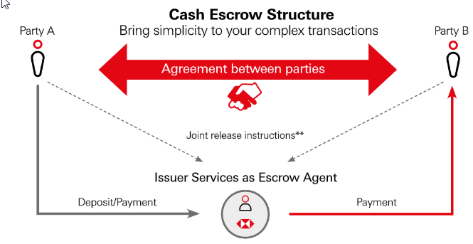
Escrow Account Related questions
Escrow Agreements
HSBC, DIGIFT to prepare an Escrow agreement with the special operation control arrangement and other standard escrow account T&C
When onboard every investor, does it require HSBC, DIGIFT and INVESTOR to sign the Escrow agreement?
Does issuer require to sign the Escrow agreement, since the issuer may need Fiat Token and Asset Token in their digital wallet
Investor onboard and account opening
If HSBC SG requires every investor to open Escrow, the processing time will be a challenge to DIGIFT sandbox express testing process.
If the investor is a FI/NBFT institutional investor, HSBC SG will taker a bit longer time to open the Escrow account vs. normal customer opens normal account.
DIGIFT can look for investor who are existing customers of HSBC, especially HSBC SG. It can greatly reduce the client onboard turn around time.

Slide 7
Cash Deposit Process
Process:
Investor to remits investment funds through its existing bank account to new opened HSBC SG Escrow account
HSBC to notify DIGIFT via API, H2H, Online Banking channel.
DIGIFT to tokenize Fiat Cash to Fiat Token through Ethereum, Credit to investor’s Digital Wallet
Notes:
The balance of the investor’s HSBC Escrow account equals to the balance of the investor’s Fiat Token in his/her digital wallet
The total number of Fiat Token has been increased after Cash Deposit process

Slide 8
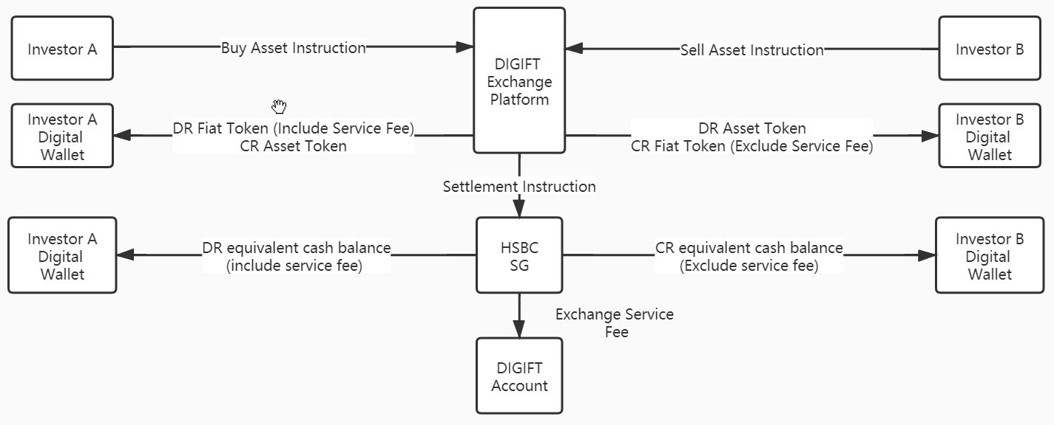
Digit Assets Exchange process 1
Business Case
Investor A to buy asset token
Investor B to sell asset token
DIGIFT to provides exchange service an token settlement service
HSBC to provide cash settlement service
Process
Investor A/B to send buy/sell instruction through DIGIFT exchange platform.
DIGIFT platform to match buyer/seller instruction, crate the deal
DIGIFT to debit and credit Investor A/B digital wallet.
DIGIFT to deduct Fiat Token from A/B to cover transaction fees
DIGIFT to send instruction to HSBC to settle the Cash on A/B nostro account
HSBC to DR/CR the buyer/seller Escrow account.
HSBC to CR service fee to DIGIFT account
Notes:
This process assumes DIGIFT can send settlement instruction to HSBC to DR/CR Escrow account between buyer/seller/DIGIFT (for service fee).
It doesn’t require investor’s consent through HSBC’s platform, assume client’s buyer/seller instruction has authorized DIGIFT/HSBC to perform it
After the transaction the total amount of Fiat Cash and Fiat Token in buyer/seller Digital Wallet match their Escrow account cash balance.
DIGIFT needs to deactivate certain number of Fiat Token with the amount equals to the exchange service charges that HSBC credit to DIGIFT’s account. This is to ensure the total Fiat Cash amount equal to all investor’s Escrow cash balance

Slide 9
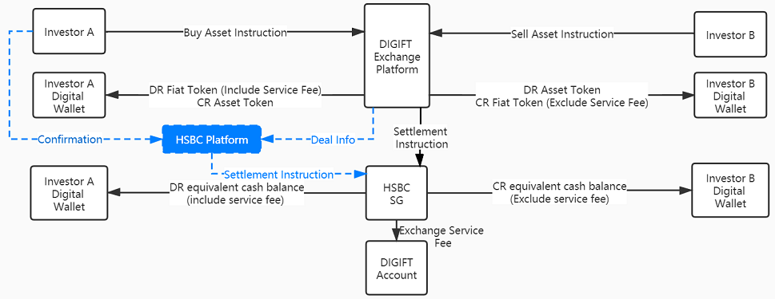
Digit Assets Exchange process 2
Business Case
Same as “Digital Access Exchange Process 2”
Process
Assume it requires both DIGIFT and Investor’s explicit instruction to debit investor’s HSBC escrow account.
The addition steps to process 1
HSBC to provide a platform (i.e. Online platform, or manual instruction channel), to allow investor to send the confirmation to deduct their Escrow account
After DIGIFT settles the exchange deal, DIGIFT to pass deal information to HSBC platform.
The seller to provide confirmation.
HSBC to match DIGIFT settlement instruction and seller’s confirmation, then proceed the settlement process
Notes:
Need to check whether HSBC existing system and operational process can support such flow?
If not, what is the alternative / workaround proposed by HSBC?
Besides the cash settlement, how about the assets settlement if DIGIFT also needs to use “Escrow account” solution to handle individual investor’s asset? Can we use the “TRUST” concept to store all Asset with HSBC Trust, then issue Asset Token. During day2day transaction stage, DIGIFT records all Asset Token information in Ethereum block chain, no need to update HSBC in investor level. DIGIFT and HSBC needs to ensure total asset level matching, i.e. every asset token has its underlying financial asset with HSBC
Settlement Risk: If investor A delayed or even not provide confirmation through HSBC platform. Shall DIGIFT reverse the transaction? Or DIGIFT clearing rulebook, customer agreement can authorize DIGIFT/HSBC to do the force settlement?

Slide 10
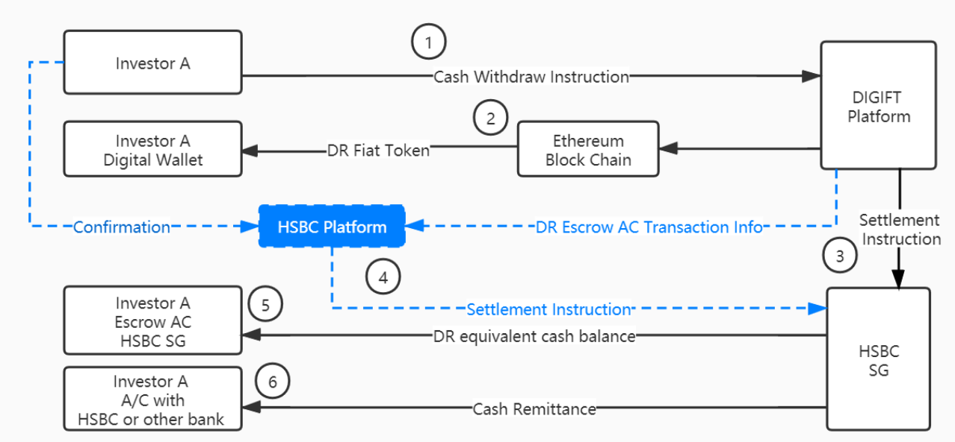
Cash Withdraw
Business Case
Investor wants to withdraw cash from digital wallet to its normal bank account with HSBC or other banks
Process
Investor sends cash withdraw request to DIGIFT.
DIGFT DR Fiat Token from investor’s Digital Wallet, deactivate, send information to HSBC
HSBC pass the information to its platform (online auto or offline manual channel). Investor needs to confirm the transition.
HSBC DR investor Fiat currency amount from Escrow account, remits to Investor’s normal account within HSBC or in other bank
Notes:
This process is based on the assumption that Escrow account outbound transaction must get approval from both DIGIFT and the account owner – the investor
After transaction the number of Fiat currency balance in the investor’s Escrow account should be equal to Fiat Token in investor’s digital wallet
Require HSBC to provide a platform for Investor to confirm the transaction could require HSBC special operation process and/or system development. All of that could bring high risk for HSBC to support this project.
There is risk that the investor’s delay to provide the confirmation to HSBC, impact the whole withdraw process

Slide 11
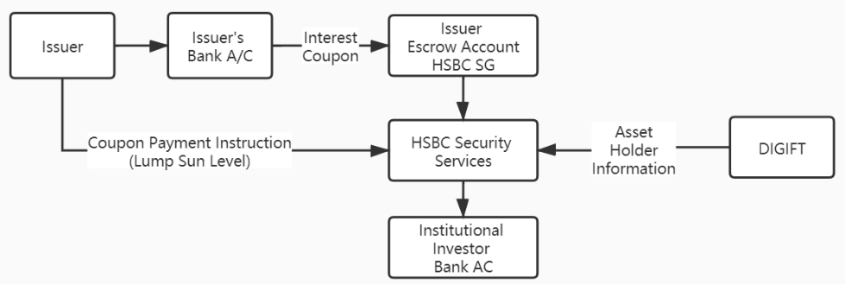
Coupon / Interest Payment – Option 1
Business Case
Issuer to pay bond coupon (interest) to bond holders (investors)
It goes through pure cash process, doesn’t engage digital wallet and fiat token.
Process
Issuer remits total coupon amount to Issuer’s HSBC Escrow AC. Issuer also provides instruction to HSBC to make coupon payment (Lump sum level, Debit Authority)
DIGIFT provides individual level coupon payment information to HSBC, based on asset holder information (who holds how much)
HSBC to debit lump sum total amount from Issuer’s Escrow account, remits to investor’s normal AC with HSBC or 3rd party bank
Notes:
This process doesn’t engage Fiat Token process.
It is directly settled through traditional cash process.
Investor can directly receive coupon cash from its normal AC with HSBC or 3rd party bank.

Slide 12
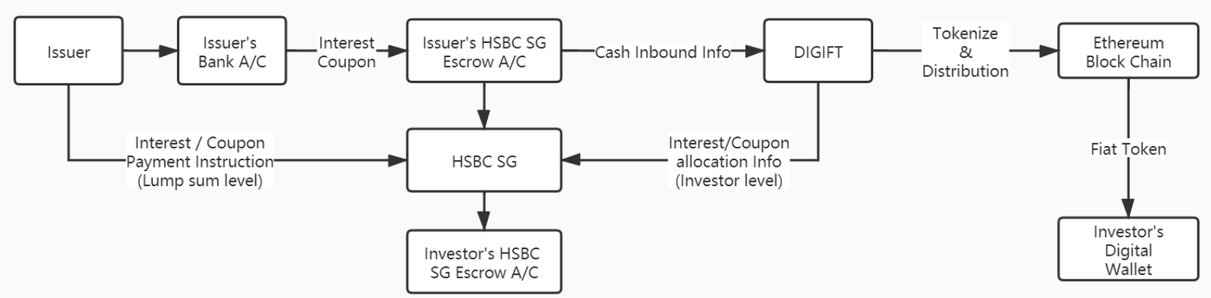
Coupon / Interest Payment – Option 1
Business Case
Issuer to pay bond coupon (interest) to bond holders (investors)
Fiat Cash is credited to individual investor’s Escrow AC, and Fiat Token is credited to investor’s Digital Wallet
Process
Issuer to remit total coupon amount to Issuer’s HSBC Escrow AC. Issuer also to provide instruction to HSBC to make coupon payment (Debit Authority)
HSBC to provide coupon inbound information to DIGIFT. DIGIFT tokenize to Fiat Token, credit to individual investor’s Digital Wallet.
DIGIFT to HSBC individual investor’s Fiat Token credit information.
HSBC to DR Issuer’s Escrow account, CR individual investor’s Escrow account according to DIGIFT’s information
Notes:
This process converts cash coupon to Fiat Token, then credits to asset holder’s Digital Wallet. Meanwhile HSBC to debit issuer’s escrow account, credit cash to asset holder’s escrow accounts.
The balance of investor’s escrow account and Digital Wallet will be increased equally. The total Fiat Token on blockchain will be increased with Total coupon payment amount

